Slide 1
Employee Data Analysis Using Excel
NAME : HEMASUNDARI T
RIGISTER NO : 122201117,unm299bcom(cs)14/ 950178
DEPARTMENT : B.COM(COPORATE SECRETARYSHIP)
COLLEGE : SSKV COLLEGE ARTS & SCIENCE FOR WOMEN

Slide 2

Project title
Employee Performance Analysis Using Excel

Slide 3

AGENDA
Problem Statement
Project Overview
End Users
Our Solution and Proposition
Dataset Description
Modelling Approach
Results and Discussion
Conclusion

Slide 4
PROBLEM STATEMENT
Track employee performance rating overtime
Identify top performers and underperformers
Analyze performance by department, job role, and other categories
Visualize trends and correlations in performance data
Enable filtering and drill-down capabilities for in-depth analysis

Slide 5
PROJECT OVERVIEW
Effective employee performance management is crucial for organizations to achieve their goals and objectives.
This project will involve collecting and cleaning employee performance data, designing and developing an interactive Excel dashboard, and creating a user guide and data dictionary for easy adoption.

Slide 6
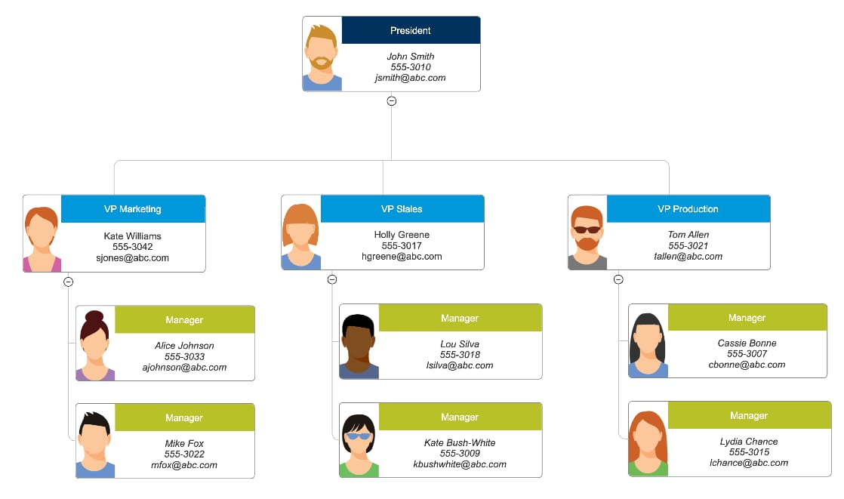
WHO ARE THE END USERS ?
HR Managers
Department Heads
Team Leads
Line Managers
Talent Management
Business Analysts
Executives

Slide 7
OUR SOLUTION AND ITS VALUE PROPOSITION
Conditional formatting – mission
Filter-Remove
Formula – performance
Pivot-summary
Graph-data visualization
Conditional formatting: Our Excel based Employee performance Analysis Solution utilizes Conditional formatting to provide a clear and intuitive visualization of Employee performance data.

Slide 8
Filter – Remove: By incorporating filtering and removal capabilities, our solution empowers HR managers and leaders to efficiently analyze and visualize employee performance data, driving informed decision-making and business success.
Formula – performance: By leveraging formulas and performance metrics in Excel, our solution provides a powerful and efficient tool for employee performance analysis enabling HR managers and leaders to make informed decisions and drive business success.

Slide 9
Pivot- summary: By leveraging pivot tables and summary reports in Excel, our solution provides a powerful and flexible tool for employee performance analysis, enabling HR managers and leaders to Make informed decisions and drive business success.
Graph-data visualization: By leveraging graphs and data visualization in excel our solution provides a powerful and intuitive tool for employee performance analysis, enabling HR managers and leaders to Make informed decisions and drive business success.

Slide 10
DATASET DESCRIPTION
Employee dataset- KAGGLE
26 Features
9 Features
Employee ID – NUM
Name – Text
Employee Type
Performance Level
Gender- Male, Female
Employee Rating – NUM
Business Unit
Employee Status

Slide 11
THE “WOW” IN OUR SOLUTION
Performance level==IFS(Z4>5,”VERY HIGH”,
Z4>=4,”HIGH”,Z4>=3,”MED”,TRUE,”LOW”)

Slide 12
MODELLING
Data Collection
Kaggale
Search employment performance
Then download employee data
Feature Collection
Feature Identify
Color filled blank Values
Data Cleaning
Missing Values Identify
Missing Values Filter out

Slide 13
Summary
Open pivot table
Drag rows, cols, filters, values respectively Business Unit, performance level, Gender Code, count of first name.
Remove the blank Option.
Visulazation
Put recommended Graph
Filter Out the linear and exponential features
To get pie chart for our reference.

Slide 14
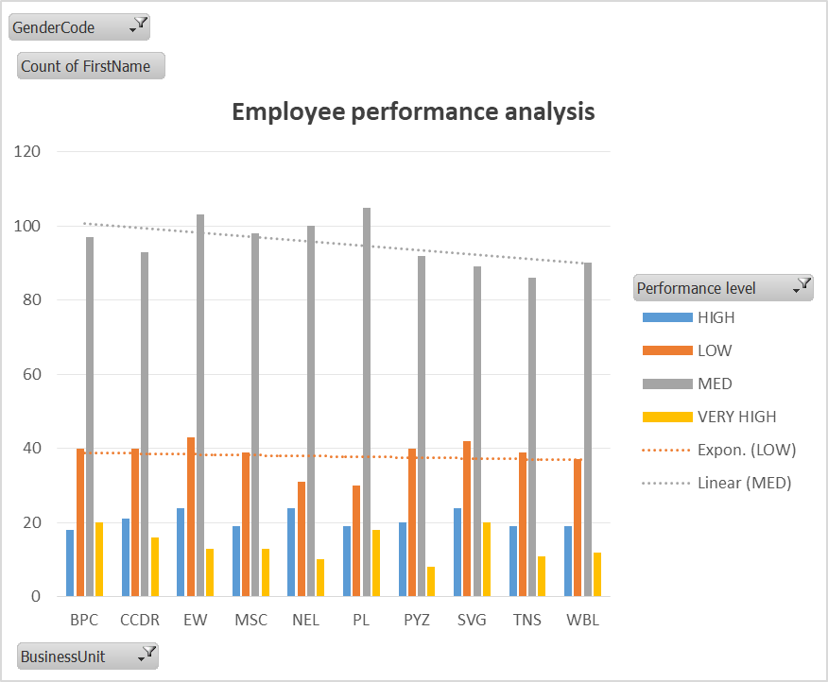
RESULTS AND DISCUSSION

Slide 15
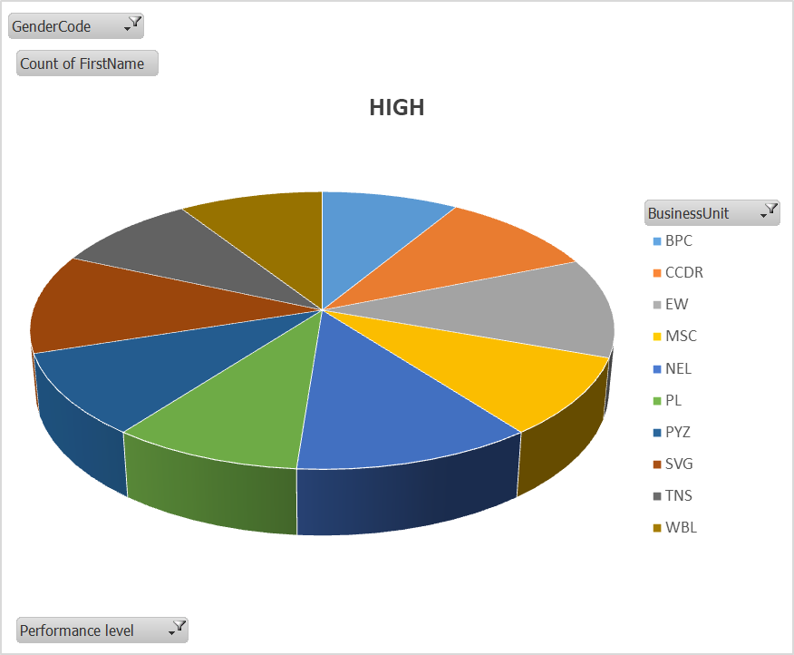

Slide 16
CONCLUSION
Our Employee performance analysis solution Using Excel provides a comprehensive and user-friendly tool for HR managers and leaders to analyze and visualize employee performance data. By leveraging Excel’s powerful features, including conditional formatting, filtering, formulas, pivot tables, and data visualization

